Slide 2
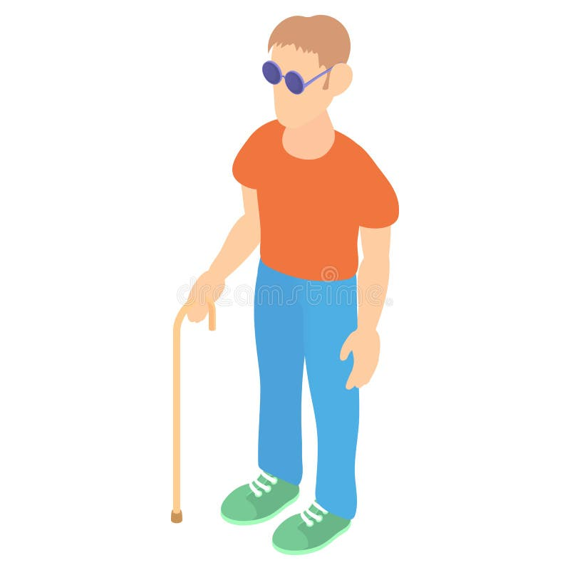

Slide 3
There is a need for accessibility technology.
Over 40m people are blind worldwide
Need to find groceries in the supermarket with ease and independence

Slide 4




The solution lies in the intelligent combination of different data sources.
Supermarket
Cisco Spaces Cloud
Camera and gyroscope data
AI and AR

Slide 5
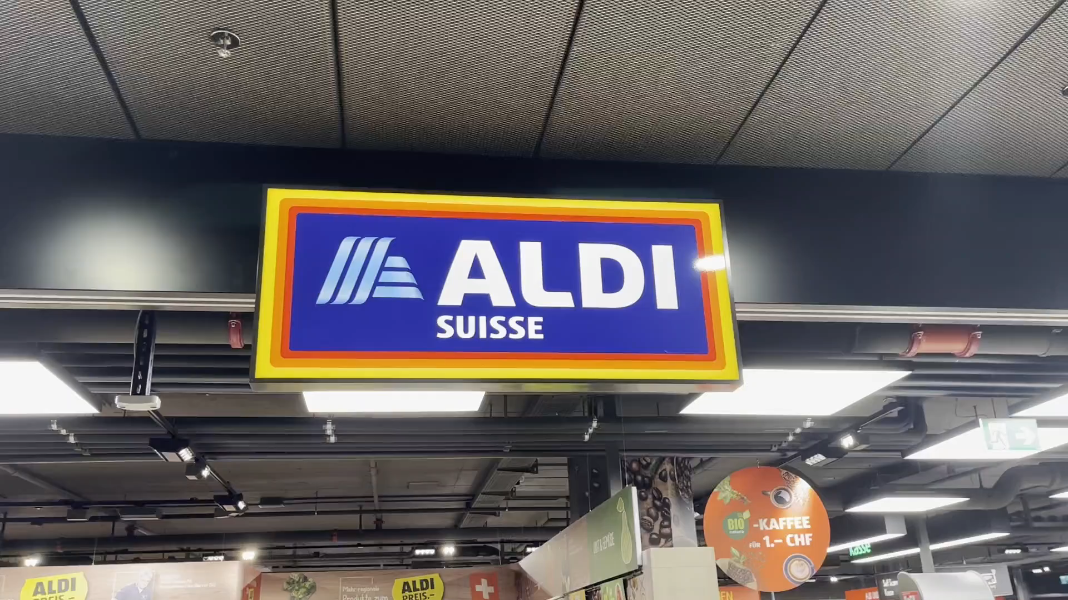

Slide 6


NavEye will be run in the Cisco Partner App Center.
Cisco Spaces Cloud
Supermarket

Slide 7
NavEye is a USP for supermarkets as well as Cisco.
Increased social responsibility
Additional selling point
Cost-effective to run and implement

Slide 8
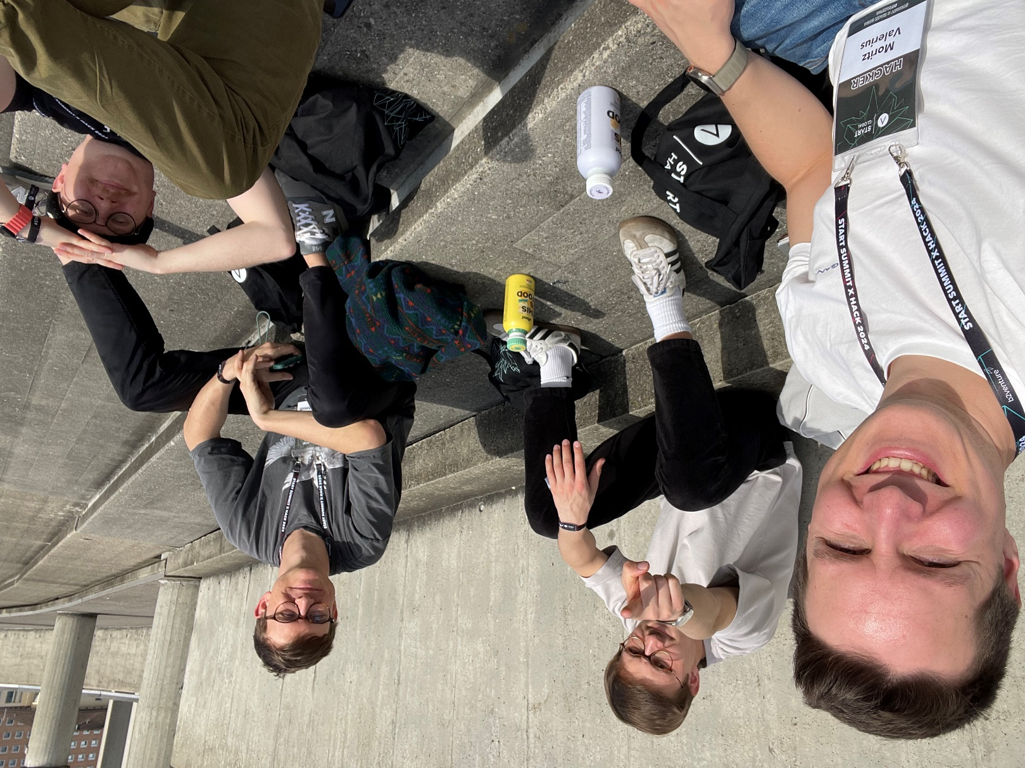
Reach out to discuss ideas!
Moritz Valerius
Leon Schmidt
Lukas Goldschmidt
Niklas Koch
LinkedIn
LinkedIn
LinkedIn

